Slide 1
Beyond the Box Score: Deep Dive into the Stats
By Michael Benno

Slide 2
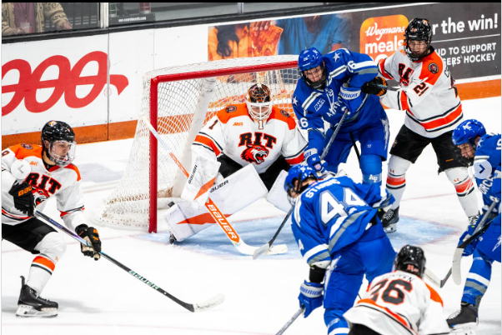
What are the questions behind your analysis?
Introduction
Based on the points per game average, who is projected to be the top scorer at the end of the season?
Based on the shooting/scoring percentage, who needs the most help to improve on scoring/getting the puck in the back of the net?
How many and what percentage of the goals scored were from special teams? (from short handed and power play goals)
Who are the strongest players defensively, in terms of blocks?
Photo: @e.rphotography_/RIT Athletics

Slide 3
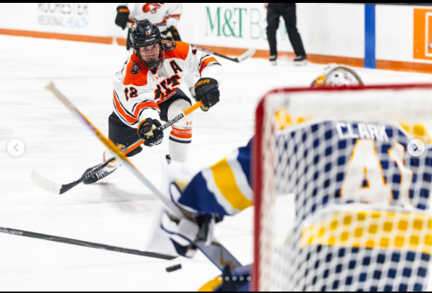
What is the purpose of your analysis?
To look at some of the overall and specific stats of players to see:
What needs to be improved upon
Some strengths/weaknesses of the team
Photo: Mikaela Engstrom/RIT Athletics

Slide 4

Who benefits from exploring this question?
Primarily the coaching staff
Insights on the team
Use to help improve the team/players
Subsequently the players
See some areas to improve on
Example: better puck location on net when shooting
Photo: RIT Athletics/Men’s Hockey

Slide 5
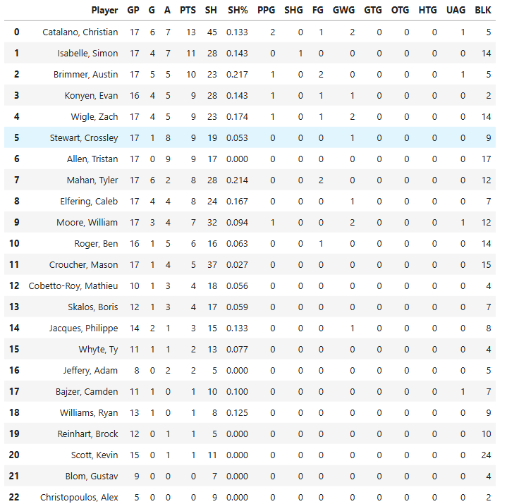
Methodology
Dataset used was the individual stats page from the team
Obtained by web scraping
Stats worked with specifically (as of the 12/5/25 series):
Goals
SHG, PPG, total goals overall, and of each type
Blocks from each player
Shooting Percentage
Points per game
Tools used:
Jupyterlab notebook and Python
Gemini (very minimally)

Slide 6
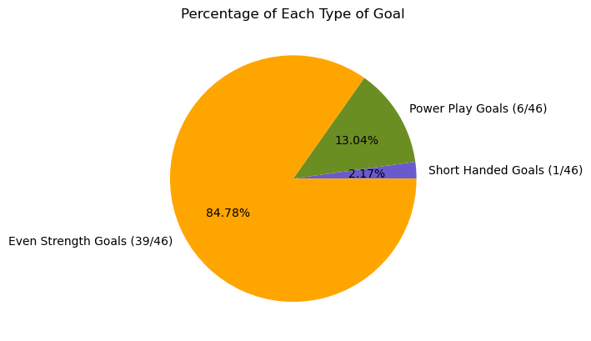
Results/Insights
Some Notable Findings
Question asked:
How many and what percentage of the goals scored were from special teams? (from short handed and power play goals)
Did it lead to more questions?
Yes:
What percentage of shots are going on target in the power play?

Slide 7
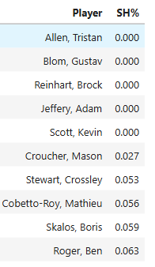
Results/Insights (Cont.)
Question:
Based on the shooting/scoring percentage, who needs the most help to improve on scoring/getting the puck in the back of the net?
Follow up/new questions:
Where are their shots going on net?
Side note:
Average shooting percentage of the team is 0.0899.

Slide 8
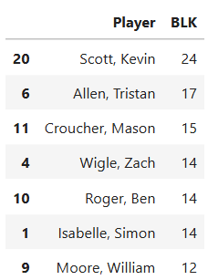
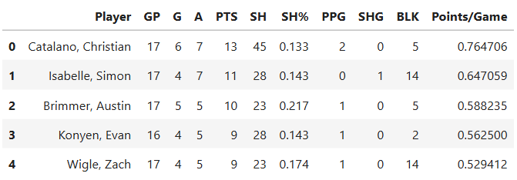
Results/Insights (Cont.)
Who are the strongest players defensively, in terms of blocks?
Based on the points per game average, who is projected to be the top scorer at the end of the season?

Slide 9

What new questions would you want to pursue?
What is the overall save percentage and goals against average for the goalies on the team?
Attendance per game average?
Explore the stats from the women’s team as well
Photo: Rit Athletics/Women's Hockey Team

Slide 10
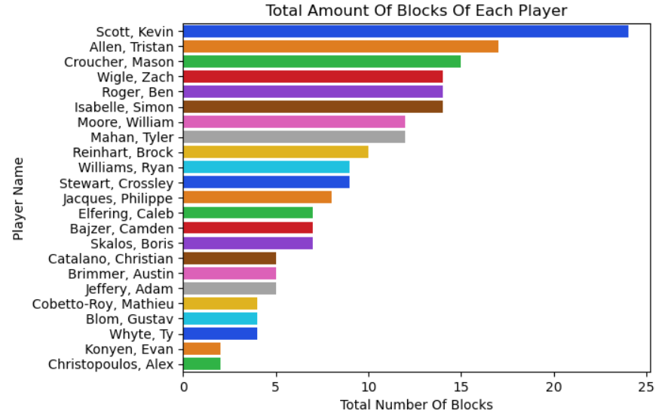
Appendix

